Slide 1

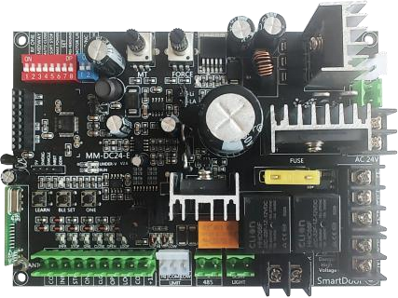


BG-DC4500
Control board for DC sliding gate openers
1 , Anti-rush design. At the first operation after each power on, the motor runs in slow motion to the end stop to avoid rushing out of the limit. When the door reaches the end stop, the motor can only be operated by pressing the button of the opposite direction to avoid breaking out of the limit.
2 , Co-op mode available. Two motors with the same type of control board on each can work synchronously. In this mode, infrared, ground sense, auto- close and other functions are synchronized.
3 , Motor runtime protection. To prevent the motor from running if travel distance fails, the control board automatically learns the motor running time, and 10 s is added automatically as the time margin.
4 , Auto- close function. Countdown can be set from 1 s to 2 5 0 s.
5 , Soft start & stop. High performance soft start and stop. The speed of the slow stop sector can be adjusted simply by rotating the MT knob.
6 , Resistance stop & rebound. Switchable resistance stop and resistance rebound for the closing travel. Resistance stop for the opening travel.
7 , Onboard socket for bluetooth module. A socket is integrated onboard for the standalone bluetooth module ( module not included by default) . 8 , Easy connection for network control. Can be directly paired with Wi Fi controllers simply through pressing one button onboard, or use the Wi Fi controller to copy the remotes paird with the control board.
Dip switches
OFF ON
1 : One/ Four- button mode Four-button mode One button mode
2 : Pedestrian mode Lock button Pedestrian mode
3 : Auto- close enabled Auto- close Auto- close on
⁴ : ^{Soft} ^{start&} ^{stop} off No soft With soft start& stop
⁵ : ^{Max} ^{speed} ^{start} start& stop Normal Max speed start
⁶ : ^{Save} ^{settings} speed start Save Setting mode
⁷ : ^{Resistance} ^{stop/} ^{rebound} Resistance stop Resistance rebound
8 : Rotation direction ^{Open} ^{to} ^{the} ^{right} Open to the left
Configuration Guide
Parameters
Working Voltage | AC220V/ 110V ± 10% input, DC 36V output
Maximum Output Voltage | 15A
Fuse | 25A-30A
Remote control distance | Over 30 meters in open area
Ambient temperature range | -30° ~+70°
Relative humidity | <60% , NO CONDENSATION
Gate Speed | 15M/Min
Motor Speed | 1700RPM
Rated Power | 550W
Limit | Spring
Protection Class | IP65
Torque | 97N.M
1 : NO/ NC 2 : Co- op mode | Normally open Auxiliary motor | Normally closed Master motor
OFF
ON

Slide 2



















 | Default mode ( Lock button enabled) Press to lock the remote, press to unlock. Pairing: When ① and ② are at OFF. Hold down the STUDY button until a beep, then hold down any button among on the remote, release it against a beep, the pairing procedure is complete. Pedestrian mode ( Lock button disabled) Press to operate the gate in pedestrian mode. Pairing: When ① is at OFF and ② is at ON. Hold down the STUDY button until a beep, then hold down the button on the remote, release it against a beep, the pairing procedure is complete.
 | One- Key circle mode The specific button pressed while pairing is the button to operate the gate in the circle of OPEN - STOP - Close.
 | One-key mode
 | ( 1) Turn ① to ON.
 | ( 2 ) Press STUDY button on control board, press and hold
 | any key which you want to set it as the key to open and
 | close the gate to pair the remote. (3)After that please keep dip switch ① on.
 | * After setting, other switches set before can be turned
 | back on.
 | Delete all paired remotes
 | Hold down the STUDY button for about 7s, release it against 3 continuous beeps to delete all paired remotes.
 | Make sure the gate is completely closed ( The CLOSED end stop is triggered) .
 | ( 1 ) Turn and only turn ③ and ⑥ to ON. ( 2 ) Each press of ONE gains 1 second to the countdown timer, press ONE as many times as you wish the coundown time in second to be. Up to 250 s can be set. ( 3 ) Turn ⑥ to OFF after setting and leave ③ ON. * After setting, other switches set before can be turned back on.
 | Countdown starts ONLY when the gate is fully open ( The OPEN end stop is triggered) . The gate will automatically close after the countdown runs out.
CLOSED
AUTO CLOSE
Travel Distance Learning
( 1) Turn ④ and ⑥ to ON.
( 2 ) Hold down ONE until the gate starts running, release . ( 3 ) Wait until the gate finishes running a full travel from the CLOSED end stop to the OPEN end stop with 2
continuous beeps.
( 4 ) Turn ⑥ to OFF after setting and leave ④ ON.
* After setting, the motor runs with the soft start & stop effect.
OPEN
+
Rotate the MT knob clockwise to gain the speed of the soft stop sector, rotate it anti- clockwise to reduce the speed.

Slide 3
















Soft- start enabled
Normally Open
When ① is at OFF, the limit switch is normally open.
When ⑤ is at OFF, the soft-start effect is enabled.
Max speed startup enabled
When ⑤ is at ON, the motor runs at its max speed since the time it starts running.
Normally Closed
When ① is at ON, the limit switch is normally closed.
Factory setting of this function is recommended, please leave it untouched.
RS485co-OP Mode
Resistance stop/Rebound
 | Resistance Stop When ⑦ is at OFF, the motor stops against resistance in both opening and closing motions.
 |  | STOP |  | STOP
 | Resistance Rebound When ⑦ is at ON, the motor stops against resistance in opening motion, but rebounds against resistance in closing motion.
 |  | Rebound |  | STOP
+ | Rotate the FORCE knob anti- clockwise to make the motor more sensitive to resistance, rotate it clockwise to make it less sensitive.
 | Auxiliary Motor When ② is at OFF, the current motor is set as the auxiliary motor
 | When ② is at ON, the current motor is set as the master motor.
RS485 | ( 1) Turn ② to ON on the master motor. Leave ② at OFF on the auxiliary motor. ( 2 ) Connect the A+ B- interfaces on the master motor to the corresponding interfaces on the auxiliary motor.
Master Motor
* After connecting, if the RUN indicators on both motors flashes synchronouly once per second, it’ s properly set.
1 , When operating the remotes paired with the master motor, and the Manual button, Study/ Delete button on the master motor as well as the Open, Stop, Close functions of any external control devices connected with the master
motor, the auxiliary motor will carry out the same operations. Meanwhile, these corresponding buttons, remotes, and external control devices are disabled on the auxiliary motor.
2 , The Resistance Stop/ Rebound function, Photocell function, Loop functions can be triggered from either motor and carry out on both motors.
3 , The Auto- Close function of the auxiliary motor is overwritten by the master motor, if this function is supposed to be used, turn on ③ on the master motor. 4 , The Soft-Stop speed and Resistance force is set on each motor separately. 5 , The Limit function on each motor works separately, it is supposed to be set on either motor before linking.
Rotation Direction swap
Switch ⑧ to swap the rotation direction of the motor
gear.

Slide 4



 | 1 , This LED is always on when the motor is powered. 2 , This LED flashes once everytime an effective RF signal is received. 3 , When setting the timer for auto- close, this LED flashes once along with a beep against each press of ONE. 4 , In the Co-op mode, this LED flashes constantly once per second. 5 , When the auto-close countdown is ongoing, this LED flashes once per second. 6 , In the motion of opening, this LED flashes once per second. 7 , In the motion of closing, this LED flashes 5 times per second.
 | UNDER- V 1 , When the voltage of the battery is in between 30 ~ 31V, this LED is always on. 2, When the voltage of the battery is lower than 30 V, this LED flashes constantly, the voltage is too low for the motor to work, please charge the battery by putting the motor on an AC pwoer supply or solar power.
 | 1 , When the bluetooth module is not bound, this LED flashes once per second constantly.
 | 2 , After binding, this LED flashes once per second when linked with the mobile app, and goes off when the app is quit.
 | 3 , After holding down the BLE key for 5s to reset the bluetooth feature, this LED stays on.
 | 1 , When charging the battery (if installed), this LED is always on. 2 , This LED goes off after full charged.
 | INFR When infrared gets triggered, this LED is on, otherwise it stays off.
 | When the ONE button is triggered, this LED is on, otherwise it stays off.
 | When the corresponding motion gets triggered, this LED is on, otherwise it stays off. When the corresponding motion gets triggered, this LED is on, otherwise it stays off. When the motor is in the stop status, this LED is on, otherwise it stays off. LOOP When the loop sensor gets triggered, this LED is on, otherwise it stays off. CL When blue ① is at OFF ( NO) : This LED is on w hen the hig her limit sensor works, otherwise it’ s off. W hen blue ① is at ON ( NC) : This LED is off when the higher limit sensor works, otherwise it’ s on.
 | OP When blue ① is at OFF ( NO) : This LED is on w hen the lower limit sensor works, otherwise it’ s off. W hen blue ① is at ON ( NC) : This LED is off when the lower limit sensor works, otherwise it’ s on.
RUN
OPEN
CLOSE
STOP
LED11
LED13
Buzzer Indicator
1 , A beep occurs each time a dip switch is switched.
2 , When both limit sensors are triggered at the same time, the buzzer keeps buzzing and the motor cannot be operated by any button, in this case the height of the magnet should be adjusted.
3 , When the gate is at the open/ closed limit position, when ▲ or is pressed,
3 continuous beeps occur and no reaction happens.
4 , Stop against resistance when opening will cause 3 continuous beeps,
stop/ rebound against resistance when closing will cause 5 continuous beeps. 5 , If the battery voltage is too low, 8 continuous beeps occur.
ONE

Slide 5
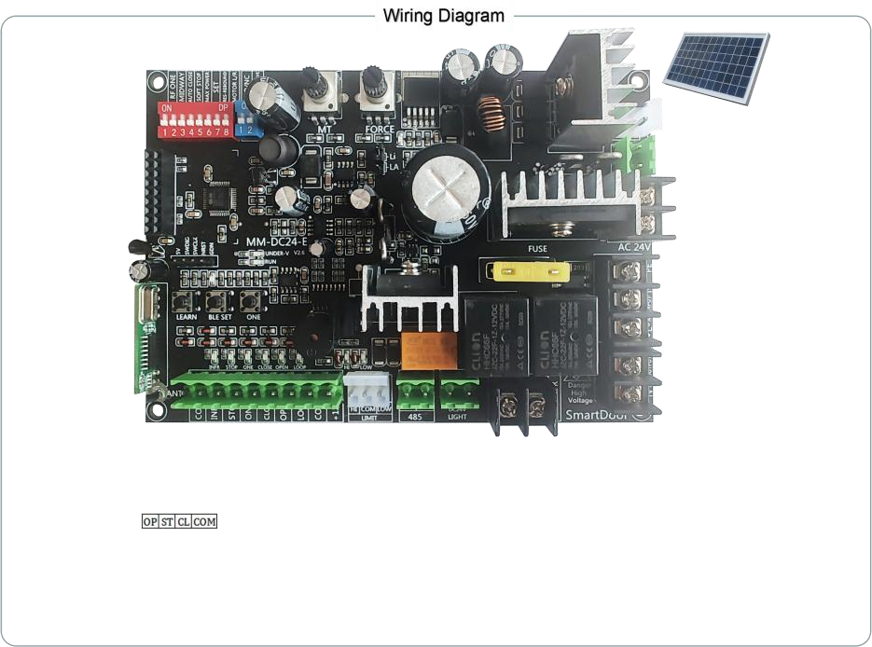




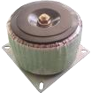




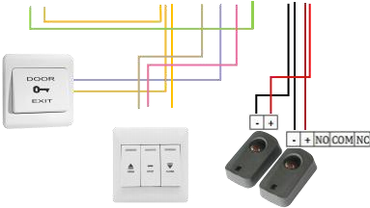





Solar Panel ( Optional)
Battery
( Optional)
Bluetooth Module
( Optional)
RFID Keypad ( Optional)
N AC L
Transformer
M ^{DC} ^{Motor}
Lamp ( Optional)
One-key Wall Switch ( Optional)
Limit Sensor
3-key Wall Switch ( Optional)
Photocell Sensor ( Optional)
Another Motor ( Optional)

